Slide 1
CS520 - Data Integration, Warehousing and Provenance
Data Curation Project
Guided By -
Dr. Boris Glavic
Pengyuan Li (TA)
Presented By -
Purva Lila (A20491945)
Shubham Singh (A20492876)
Suraj Nammi (A20501709)

Slide 2
Dataset
FIFA DATASET (SPORTS DOMAIN) - 18980 records
https://www.kaggle.com/yagunnersya/fifa-21-messy-raw-dataset-for-cleaning-exploring
Column reduction due to:
Increased Data Size
No curation tasks in the removed columns
Only numeric values and all clean values
 | Original DataSet | Modified DataSet
Number of Attributes | 77 | 24
Size | 16.3 MB | 4.82 MB
Data Format | CSV | CSV

Slide 3
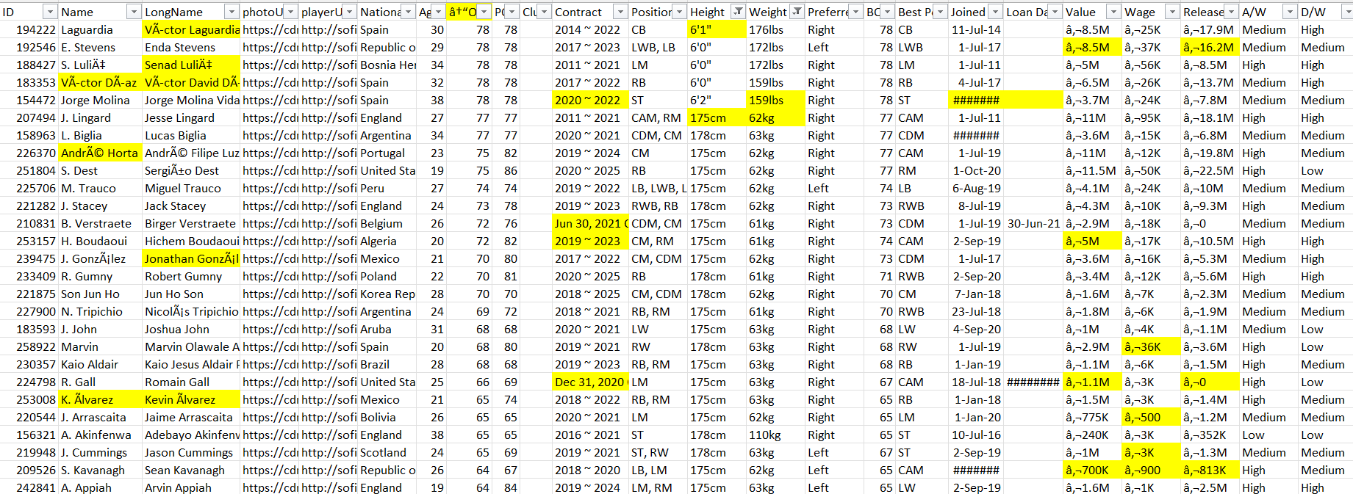
Sample DataSet

Slide 4
Overall Curation Tasks in the Dataset
Empty Values (Missing Values)
Wrong Values (Special characters, Non Ascii characters , Copyright_symbol , Trademark Symbol)
Irrelevant column header
Standardize K and M
Standardize feet and cms
Standardize KG and LBS
Standardize Date formats
Inter-column relationship - Contract and Loan

Slide 5
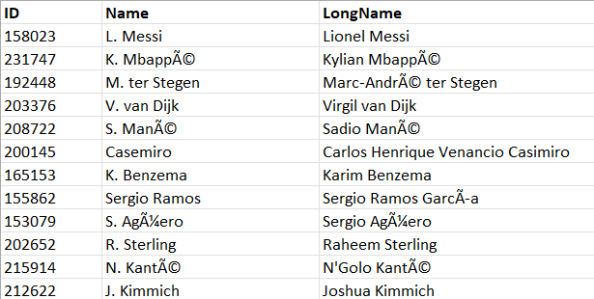
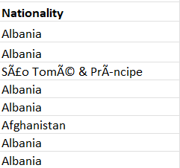
Issues in the Dataset
Name contains special characters (Non Ascii characters , Copyright_symbol , Trademark Symbol )
Long name contains Double quotes, non ascii characters, symbols (%), Copyright symbol
Nationality contains Copyright symbol, non Ascii characters.

Slide 6
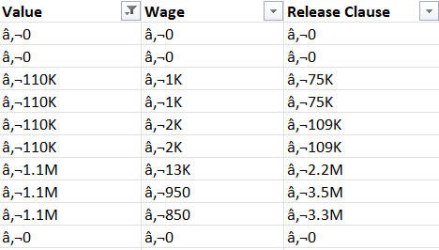
Issues in the Dataset continued…
4. Value contains non Ascii character , standardize K and M 5. Wage contains non Ascii character , standardize K and M 6. Release Clause contains non Ascii character , standardize K and M

Slide 7
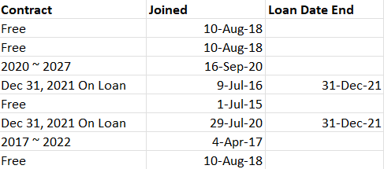
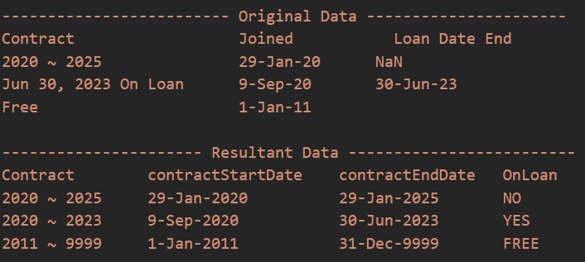
Issues in the Dataset continued…
7. Contract contains Free. Loan, time-date different representation format 8. Loan contains null fields (CONTRACT (not under loan) AND LOAN (loan = null) RELATION) 9. Standardize Date Formats

Slide 8
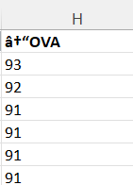
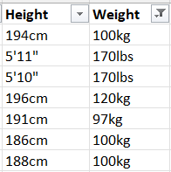
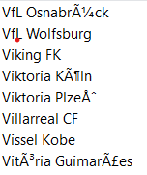
Issues in the Dataset continued…
10. Club contains non ascii characters , numbers, fractions, Empty Values 11. Column H contains Invalid header (â†“OVA - should be OVER ALL RATING) 12. Height contains different measuring formats as feet and cms 13. Weight contains different measuring formats as KG and LBS

Slide 9
Problem Identification and Curation
Identification :
Microsoft Excel Spreadsheet
Vizier visualization
Curation :
Vizier Tool
Jupyter Notebook
Python Libraries :- ⇒ Pandas - Pandas is a Python library for data analysis and data manipulation. It offers data structures and operations for manipulating numerical tables and time series. ⇒ Re - Regex library for performing regular expression related operations over data ⇒ Datetime - Date time library for curing various date formats and string to date conversions ⇒ Dateutil.relativedelta - Utility functions for date operations like addition of years, etc.

Slide 10
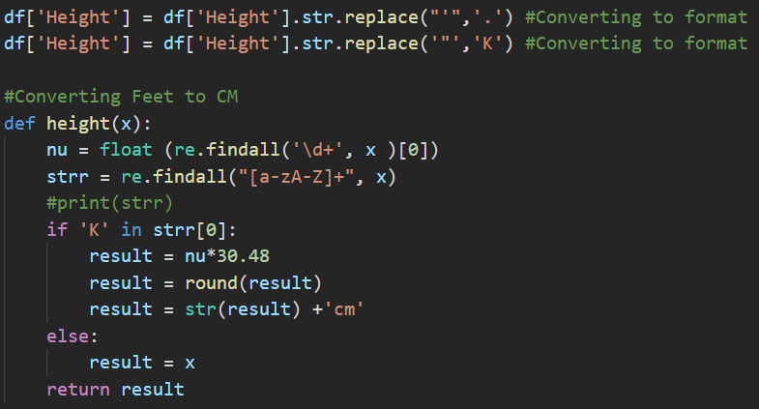
Python code Snippet
Curation of height Values
Converting height values from varied formats such as cms and feet-inches to cms only
Input | Output
175cm | 175cm
5'10" | 155cm

Slide 11
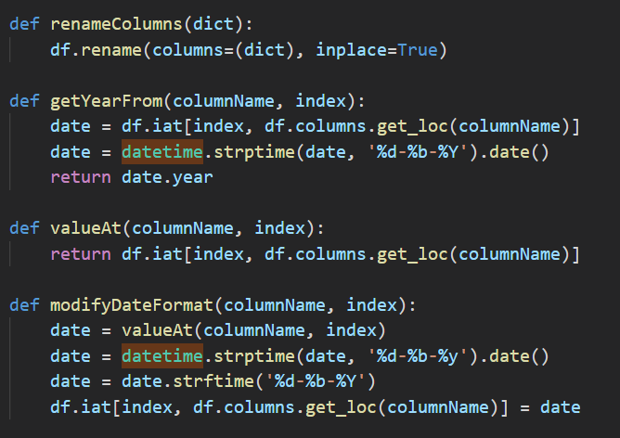
Python code Snippet
renameColumns() - To rename columns
Example : {'ID': 'EmpID'}
getYearFrom() - To retrieve an year value from date column in the dataframe object Expected Format of the Date column = '%d-%b-%Y'
Example : 29-Jan-2020 will give 2020
modifyDateFormat() - To modify date format from '%d-%b-%y' to '%d-%b-%Y' (Standardizing date format)
Example : 29-Jan-20 will become 29-Jan-2020

Slide 12
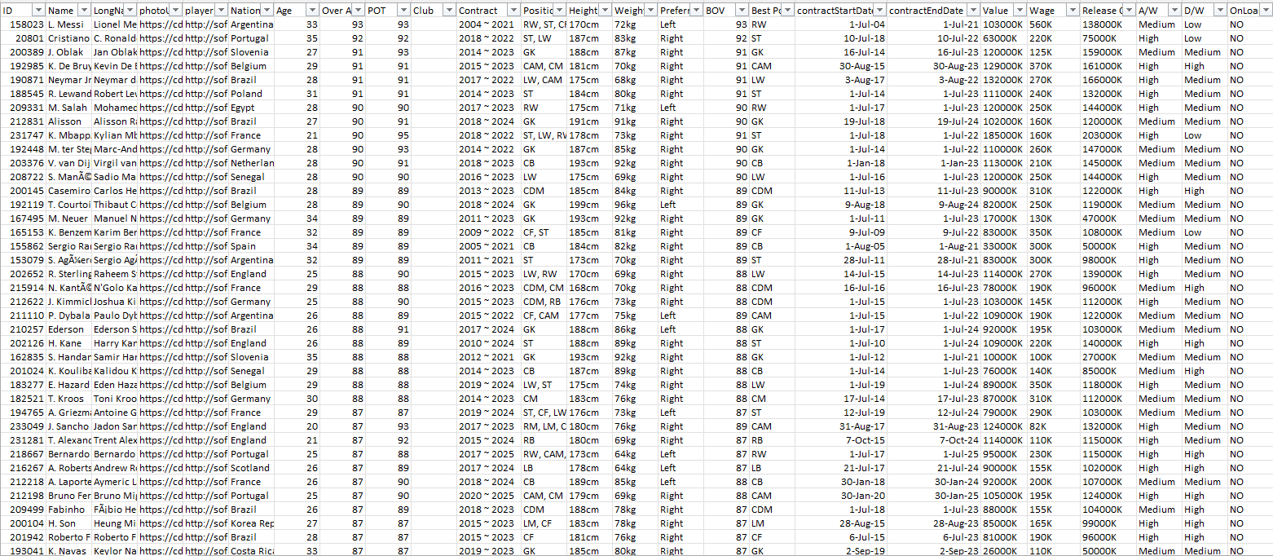
Cleaned DataSet

Slide 13
Challenges and Future Scope
Challenges Faced :
Find unclean dataset.
Inter-attribute relationship identification.
Data representation Issues.
Vizier installation.
Future scope and Statistics :
Calculate Data Nullability Rate
Calculate Missing values and Inconsistent values
Ready for Data analysis and modeling.
High-value prospects can be identified more easily.
Ready to be put under GDPR(Global Data Protection Regulation) Implementation (If required)

Slide 14


